Slide 1

SOFT354: Parallel Computation and distributed systems
Week 1
Dr Robert Merrison-Hort

Slide 2
The Lecturer
Dr Robert Merrison-Hort
Email: robert.merrison@plymouth.ac.uk
Phone: 01752 586307
Portland Square A221
Usually around if you need help, but email first!

Slide 3

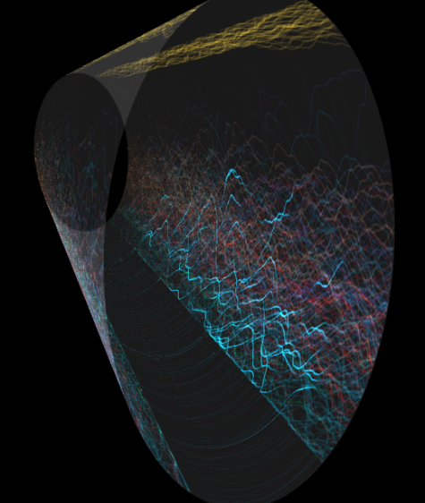
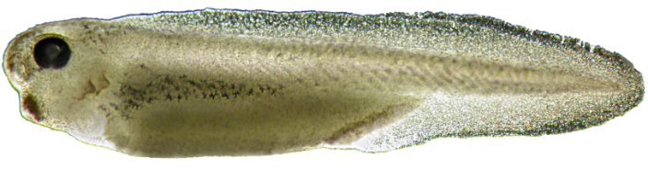
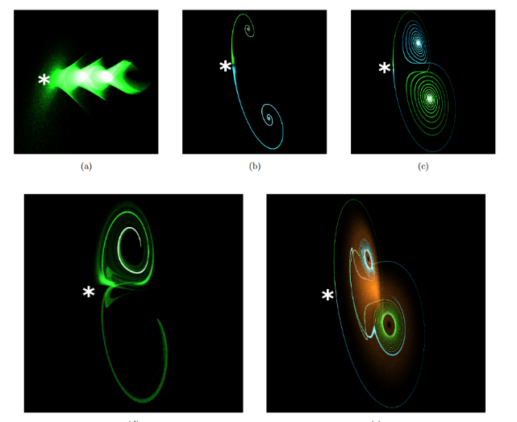

The Lecturer

Slide 4
Today’s lecture
Introduction to the module.
Introduction to parallel computing.
History of GPUs.
15 minute break.
Getting started with CUDA.

Slide 5


Module structure
Divided into two halves, dealing with different approaches to parallel programming.
First part: graphical processing unit (GPU) programming using Nvidia CUDA – massively multithreaded.
Second part: distributed (multi-process) programming using the Message Passing Interface (MPI).
These aren’t competitors, each is useful in particular situations. Possible to use both at the same time.

Slide 6
Prerequisites
We will be using C for both parts of the module. If you aren’t that comfortable with C, you may struggle.
Excellent free online C++ tutorial: http://www.learncpp.com/ (chapters 1-7 should be fine)
It will help to know a little linear algebra (matrices and vectors), but I’ll try to explain as we go along.
Parallel programming can be tricky – it requires you to think carefully, in a different way to serial programming.

Slide 7
Practical labs
Three sessions (all in BGB203):
Monday 9:00-11:00 (me)
Monday 11:00-13:00 (Max Patacchiola)
Tuesday 10:00-12:00 (Max Patacchiola)
You should be able to access BGB203 (with your uni card) until 10pm every day.
Choose a session on the DLE from 3pm today.
Those who haven’t chosen by 5pm tomorrow will be allocated groups.
If you’re planning on using your laptop, please email to let me know.

Slide 8
coursework
Worth 60% of your mark for SOFT354.
Each choose a particular computational problem and then implement two algorithms to solve it:
One serial (single threaded)
One parallel, using CUDA or MPI (your choice)
You will need to compare the performance of the two versions, and analyse which works better and why.
Need to submit your code, and a report describing your results.
Available from 24th November, due 25th January.

Slide 9
Class test
Worth 40% of your mark for SOFT354.
Thursday 8th December in the usual lecture slot.
Short / single word answers only.
We will have a practice test (doesn’t count towards your mark) on Thursday 3rd November.

Slide 10
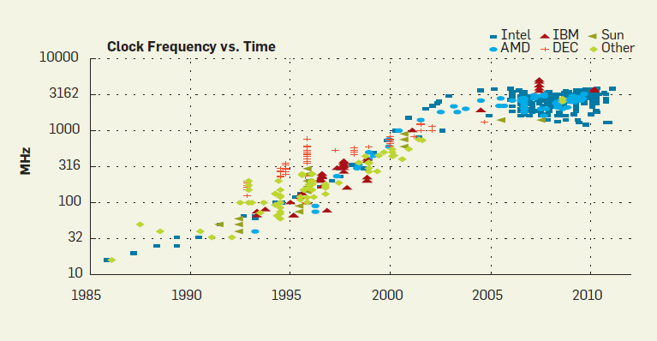
Why parallel?
Processor clock speeds aren’t getting faster:
ACM CPU Database
Notes:
There’s a good reason for this: to switch more quickly

Slide 11
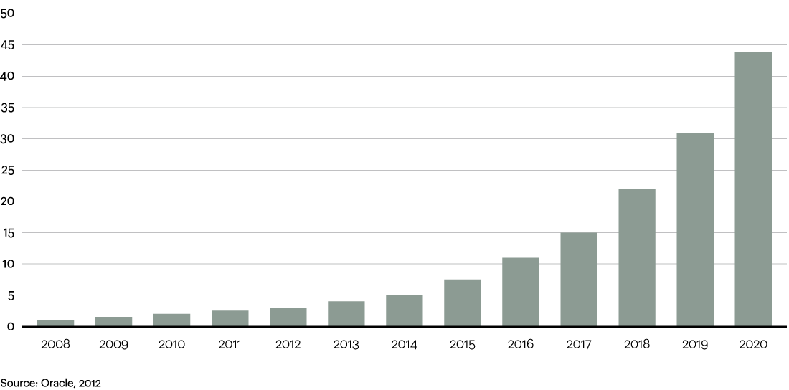
WHY PARALLEL?
But there’s a lot more data around:
Data produced per year, globally, in zettabytes (ZB)
(From Oracle)
Every day, 2.5 quintillion bytes of data are created, with 90 percent of the world's data created in the past two years alone.
Data production will be 44 times greater in 2020 than in 2009.
Wal-Mart processes one million customer transactions per hour, stored in databases estimated to contain more than 2.5 petabytes of data.
How can we deal with this?
Notes:
This is marketing data from Oracle so take it with a pinch of salt (everything beyond 2012 is a prediction, for example). But nobody can deny that the amount of data around is growing at a colossal rate. 1 ZB = 1 billion TB

Slide 12
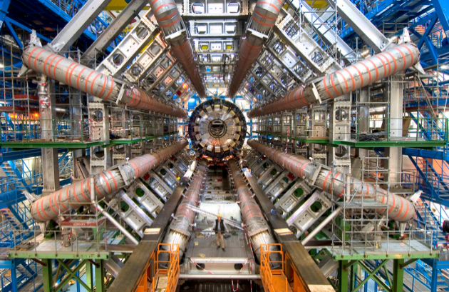
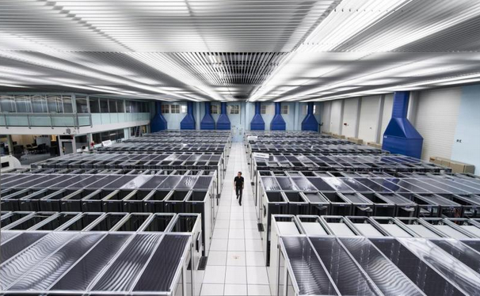
Why parallel?
Science is also pushing the boundaries of what computers are required to do.
Giant experiments produce big data.
E.g. the Large Hadron Collider produces ~25,000 terabytes of data a year.
Advanced simulations require lots of computing power.
E.g. weather forecasting, protein folding, particle physics, fluid dynamics (for car / airplane design), neuroscience.
How can we deal with this?

Slide 13
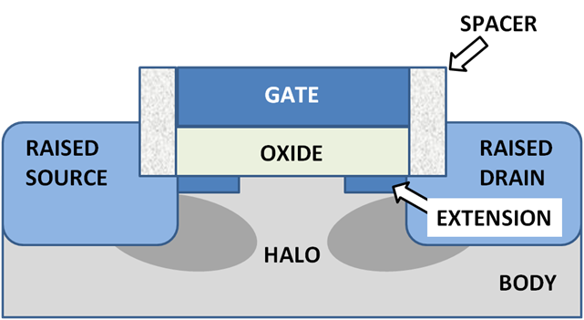
faster clock Speeds?
CPU clocks aren’t likely to get much faster.
The speed at which transistors switch increases as the gate oxide gets thinner.
In modern CPUs, the “die size” is 22nm, giving a 0.5nm thick oxide – roughly the size of a silicon molecule!
Clever new transistor designs and materials help…
e.g. iPhone 6s CPU and recent graphics cards are 14 and 16nm)
… but we’re probably close to the limit.
Notes:
Another problem is the connections between the transistors inside the microcontroller. To switch quickly, these must have low capacitance, which means they need to be short. However, putting everything closer and closer together means it generates more heat, giving another limitation on speed.

Slide 14

Solution: Parallelism
If you can’t do something any faster…
… do more than one thing at the same time!

Slide 15
Levels of parallelism
Computers can be parallel at different scales:
Within a core (instruction-level parallelism)
By having multiple cores in a CPU
By having multiple CPUs (or computers)
Let’s have a quick look at each of these.

Slide 16
Instruction level parallelism
The performance of a single processor core can be increased by doing some things in parallel.
Example: fetch-decode-execute pipelining.
Decode the next instruction and fetch the next next one while the current instruction is executing.
Fetch
Decode
Execute

Slide 17
Fetch-decode-execute pipelining
Decode the next instruction and fetch the next next one while the current instruction is executing.
Fetch Instruction 1
Fetch Instruction 2
Decode Instruction 1
Time
Fetch Instruction 3
Decode Instruction 2
Execute Instruction 1
Fetch Instruction 4
Decode Instruction 3
Execute Instruction 2
Fetch Instruction 5
Decode Instruction 4
Execute Instruction 3
3x increase in throughput.
(assuming the next instruction is predictable)

Slide 18

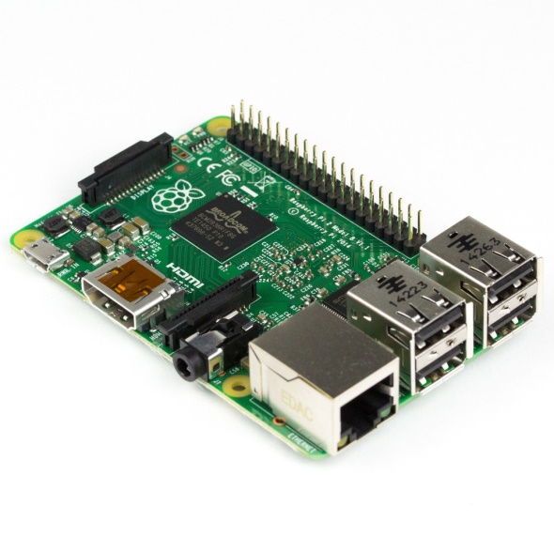
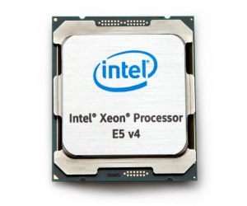
Multiple cores
Modern CPUs have several largely independent processing cores.
Raspberry Pi 2 Model B
Four 900Mhz ARM A7 Cores
Intel Xeon E5-2699
22 2.2GHz Intel Cores
Nexus 6P
Eight 2GHz A57 Cores

Slide 19
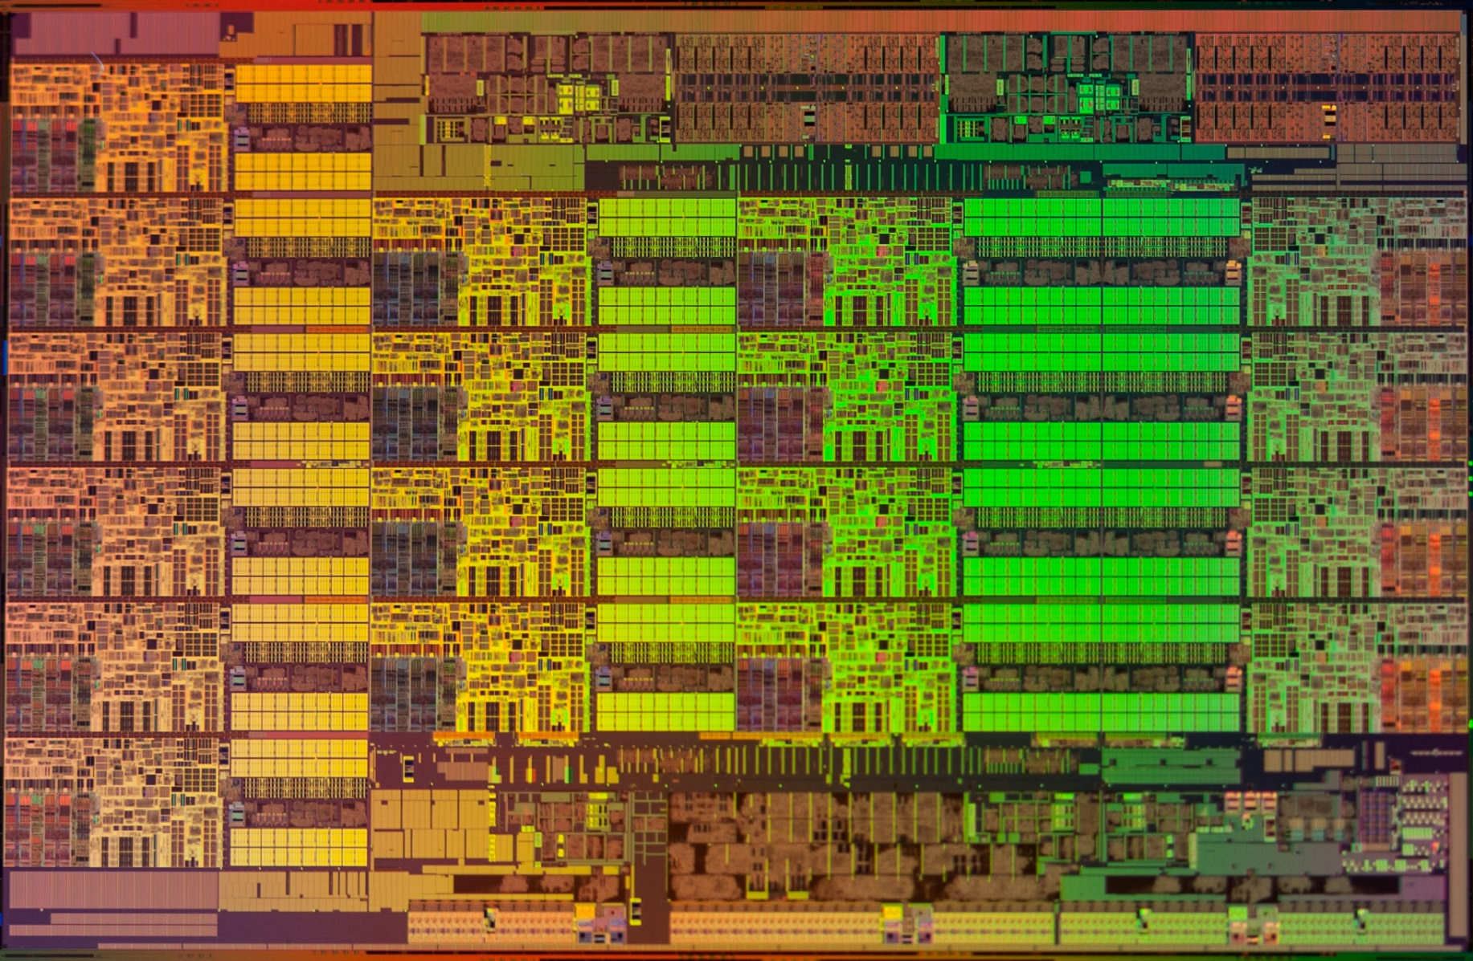

Slide 20
Multiple cores
Modern CPUs have several largely independent processing cores.
Raspberry Pi 2 Model B
Four 900Mhz ARM A7 Cores
Intel Xeon E5-2699
22 2.2GHz Intel Cores
Nexus 6P
Eight 2GHz A57 Cores
All cores have access to the same memory, but can be running different programs or threads.

Slide 21
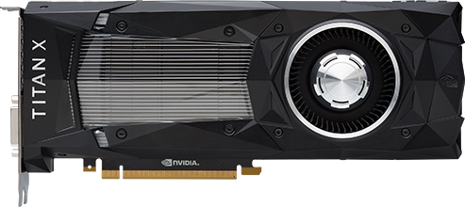
Multiple cores
Graphical processing units (GPUs) have loads of cores!
Nvidia Titan X
3,584 cores
Although these are less flexible than CPU cores.
We’ll see how to program GPUs in the first part of the module (CUDA).
Notes:
Tesla K40 has 2880. We will see how to program GPUs in the first part of this module on CUDA.

Slide 22
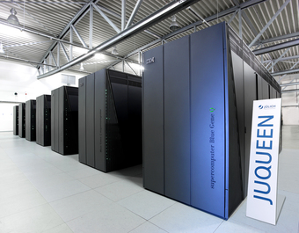
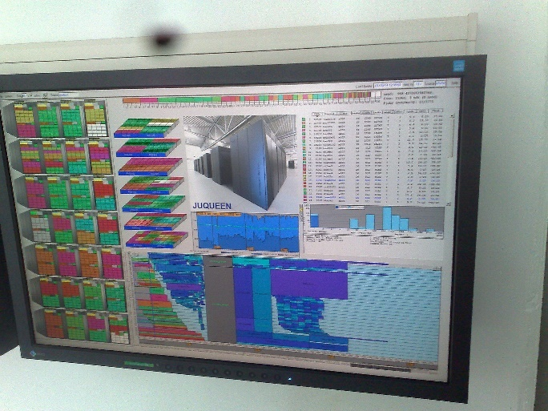
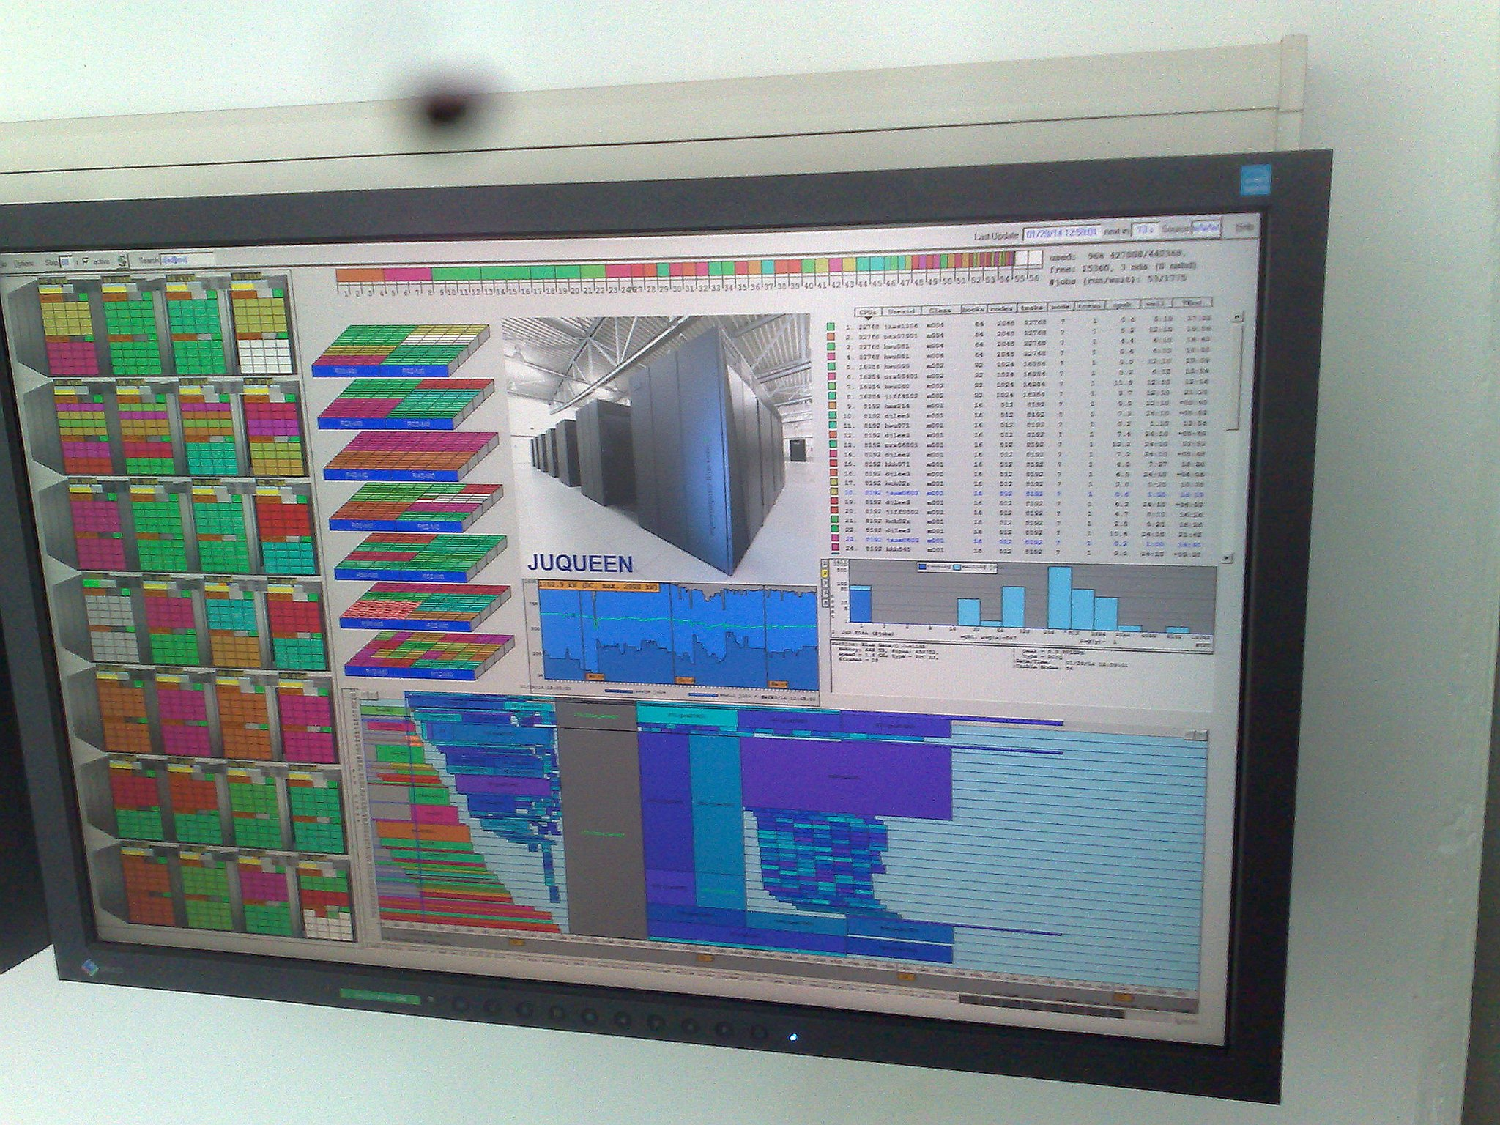
Multiple processors
Distribute a problem amongst multiple computers, connected via a network – supercomputers.
E.g. Juqueen at Jülich Research Centre, Germany.
28,672 processors; 458,752 cores.

Slide 23

Multiple processors
Two clusters at Plymouth (376 core and 752 core).
Available for students – but we won’t use them for SOFT354.
We’ll learn how code can be synchronized across a cluster in the second part of the module (MPI).
https://www.plymouth.ac.uk/your-university/about-us/university-structure/faculties/science-engineering/hpc/what-is-a-cluster

Slide 24
What’s a GPU?
A Graphical Processing Unit
… but don’t let the name confuse you – often used for computations that have nothing to do with graphics!
More accurate (but awkward) name: General-Purpose Computing on Graphical Processing Units (GPGPU).
Why the confusing name?
Short history lesson…

Slide 25
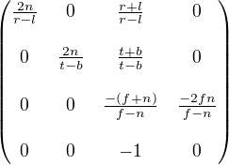
GPU History
A typical scene in a 3D computer game is made up of lots of triangles.
Each triangle is made up of 3 points in 3D space (vertices).
Rendering a scene involves applying a transformation to each 3D vertex to convert it to a position on the (2D) screen.
(Technically, multiplying by some transformation matrices).
Notes:
The matrix shown here is an example OpenGL view-projection matrix. You don’t need to learn this!

Slide 26
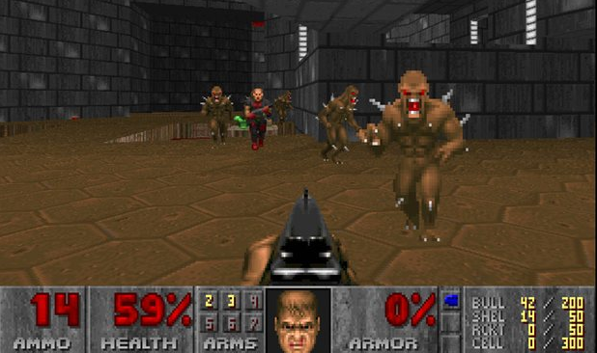
GPU History
As games got more advanced, the number of triangles and vertices increased.
DOOM (1993)
10s of triangles?

Slide 27

GPU History
As games got more advanced, the number of triangles and vertices increased.
Half-Life 2 (2004)
10,000s of triangles

Slide 28

GPU History
As games got more advanced, the number of triangles and vertices increased.
The Witcher 3 (2015)
Millions of triangles

Slide 29
GPU History
CPUs haven’t gotten a 100,000x faster since 1993…
And they don’t have 100,000 more cores…
So how can we play games with millions of triangles?

Slide 30
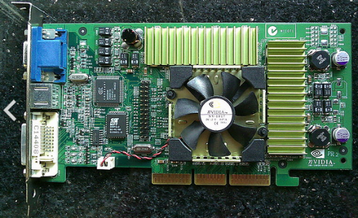
GPU History
Key insight: the transformation operation is the same for each vertex.
So why not design a processor that can perform the same operation on many different values at the same time (vertices in this case, but also pixels)?
All cores are run the same code → simpler circuitry.
Around 2001, this led to the first parallel GPUs. The number of cores continues to increase dramatically.
Geforce 3 Ti500 (2001)
4 “pixel shader” cores @ 240MHz!

Slide 31
General purpose GPUs
The Geforce 3 was revolutionary in another way: its shaders (cores) were programmable.
Rather than performing a fixed function (i.e. multiplying vertices by a matrix), you could write arbitrary code for them like you would a regular CPU.
Originally this was used to produce special graphical effects, but soon games programmers realised they could be used to optimise other things (e.g. physics).

Slide 32

General purpose GPUs
Over time, GPUs were designed more and more with general purpose parallel computation in mind.
Nowadays they don’t even necessarily have any display output ports (e.g. Nvidia Tesla).
~2009, specialist APIs appeared that made GPGPU computing much easier to access:

Slide 33
CUDA and opencl
Developed by Nvidia.
Nvidia GPUs only ☹
Free (as in beer) ☺, not free (as in speech) ☹
Great tool support, e.g. Nvidia Nsight ☺
In my experience, easier to use ☺
Developed by Khronos Group (AMD, Apple, ARM, Google, Nvidia, etc.)
Can use a wide range of GPUs and CPUs ☺
Completely open standard ☺
In my experience, harder to use ☹
The basic principles are the same in both!

Slide 34
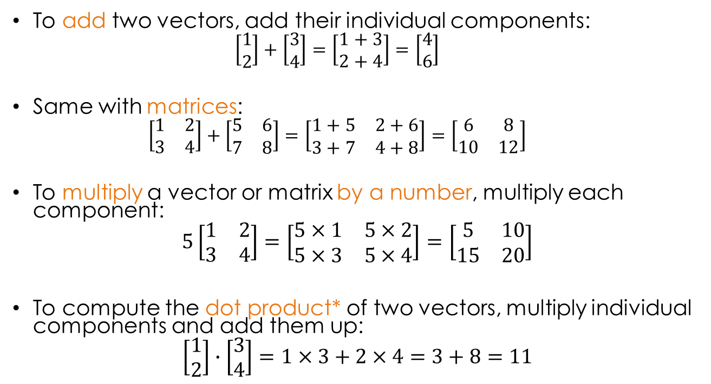
15 minute break
To add two vectors, add their individual components:
$$\left[\begin{aligned}1 \\ 2\end{aligned}\right]+\left[\begin{aligned}3 \\ 4\end{aligned}\right]=\left[\begin{aligned}1+3 \\ 2+4\end{aligned}\right]=\left[\begin{aligned}4 \\ 6\end{aligned}\right]$$
Same with matrices:
$$\left[\begin{matrix}1 & 2 \\ 3 & 4\end{matrix}\right]+\left[\begin{matrix}5 & 6 \\ 7 & 8\end{matrix}\right]=\left[\begin{matrix}1+5 & 2+6 \\ 3+7 & 4+8\end{matrix}\right]=\left[\begin{matrix}6 & 8 \\ 10 & 12\end{matrix}\right]$$
To multiply a vector or matrix by a number, multiply each component:
$$5\left[\begin{matrix}1 & 2 \\ 3 & 4\end{matrix}\right]=\left[\begin{matrix}5×1 & 5×2 \\ 5×3 & 5×4\end{matrix}\right]=\left[\begin{matrix}5 & 10 \\ 15 & 20\end{matrix}\right]$$
To compute the dot product* of two vectors, multiply individual components and add them up:
$$\left[\begin{aligned}1 \\ 2\end{aligned}\right]∙\left[\begin{aligned}3 \\ 4\end{aligned}\right]=1×3+2×4=3+8=11$$
*Also called scalar product or inner product.

Slide 35
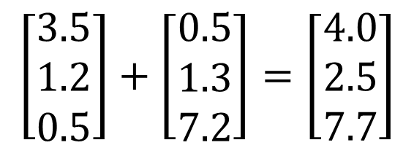
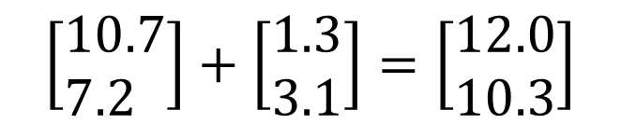
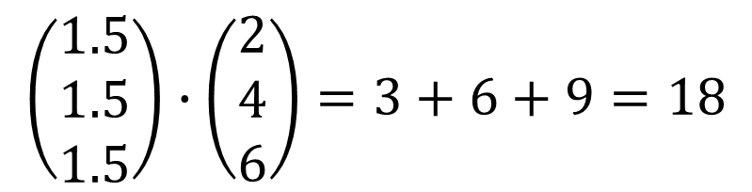
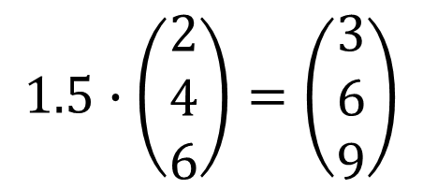
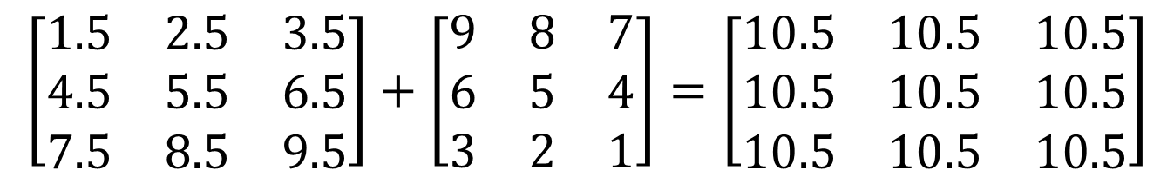
Solutions
$$\left[\begin{aligned}&3.5 \\ &1.2 \\ &0.5\end{aligned}\right]+\left[\begin{aligned}&0.5 \\ &1.3 \\ &7.2\end{aligned}\right]=\left[\begin{aligned}&4.0 \\ &2.5 \\ &7.7\end{aligned}\right]$$
$$\left[\begin{aligned}&10.7 \\ &7.2\end{aligned}\right]+\left[\begin{aligned}&1.3 \\ &3.1\end{aligned}\right]=\left[\begin{aligned}&12.0 \\ &10.3\end{aligned}\right]$$
$$\left[\begin{matrix}1.5 & 2.5 & 3.5 \\ 4.5 & 5.5 & 6.5 \\ 7.5 & 8.5 & 9.5\end{matrix}\right]+\left[\begin{matrix}9 & 8 & 7 \\ 6 & 5 & 4 \\ 3 & 2 & 1\end{matrix}\right]=\left[\begin{matrix}10.5 & 10.5 & 10.5 \\ 10.5 & 10.5 & 10.5 \\ 10.5 & 10.5 & 10.5\end{matrix}\right]$$
$$1.5∙\left(\begin{matrix}2 \\ 4 \\ 6\end{matrix}\right)=\left(\begin{matrix}3 \\ 6 \\ 9\end{matrix}\right)$$
$$\left(\begin{matrix}1.5 \\ 1.5 \\ 1.5\end{matrix}\right)∙\left(\begin{matrix}2 \\ 4 \\ 6\end{matrix}\right)=3+6+9=18$$

Slide 36
CUDA Compute Capability
The compute capability of a device describes its architecture, e.g.
Number of SMs and registers
Sizes of memories
Features & capabilities
Compute Capability | Selected Features (see CUDA C Programming Guide for complete list) | Tesla models
1.0 | Fundamental CUDA support | 870
1.3 | Double precision, improved memory accesses, atomics | 10-series
2.0 | Caches, 3D grids, surfaces, ECC, P2P, concurrent kernels/copies, function pointers, recursion | 20-series
3.0 | Dynamic parallelism | K-series
We will concentrate on Fermi devices
Compute Capability >= 2.0

Slide 37
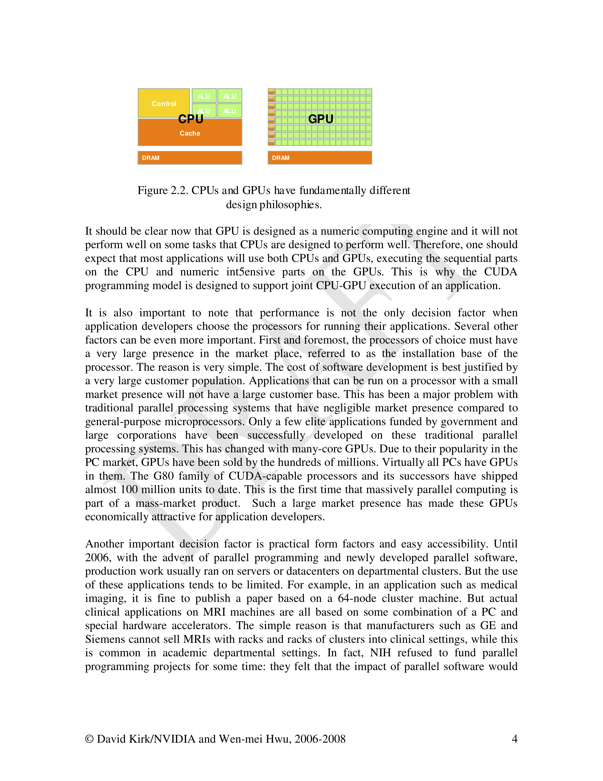
CUDA
A GPU is organised differently to a CPU.
Each CPU core has its own control logic → each thread that’s running in parallel can be at a different place in the program.
CUDA cores are organised into Streaming Multiprocessors (SMs)
E.g. In compute capability 2, there are 32 cores per SM.
All cores within an SM execute the same instruction at the same time!

Slide 38



Heterogeneous computing
CPU
GPU
Notes:
GPU Computing is a type of heterogeneous computing – that is, parallel computing with multiple processor architectures. In GPU computing,
Many-core GPUs are combined with multicore CPUs to achieve higher performance.
Today’s CPUs have 4, 6, 8 or even 12 cores, while GPUs have up to 512 cores in a single chip.
Today’s computing applications typically have data intensive regions with a large amount of inherent parallelism. GPUs accelerate these parallel
Regions by spreading the computation over hundreds of cores. This can deliver significant acceleration for many applications.

Slide 39
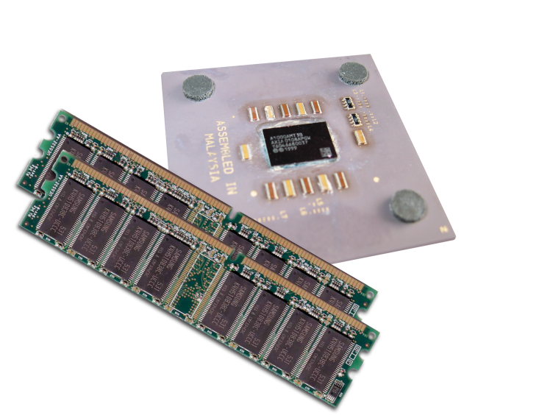
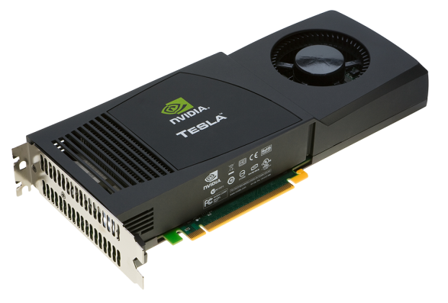


Heterogeneous computing
Application Code
Host
Device
GPU
Compute-Intensive Functions
CPU
Rest of Sequential
CPU Code
Use GPU to Parallelize
+
Notes:
Your time is precious, which is why performance is critical. So you need to focus on what’s important.
To add GPU acceleration, simply identify and accelerate the *performance-critical areas* in your application.
The rest can run as-is on the CPU. There’s no need for an entire application to be ported to the GPU.
The key point here is that in a hybrid architecture where GPUs and CPUs are working together, developers only need to accelerate performance-critical functions on the GPUs in the system.

Slide 40
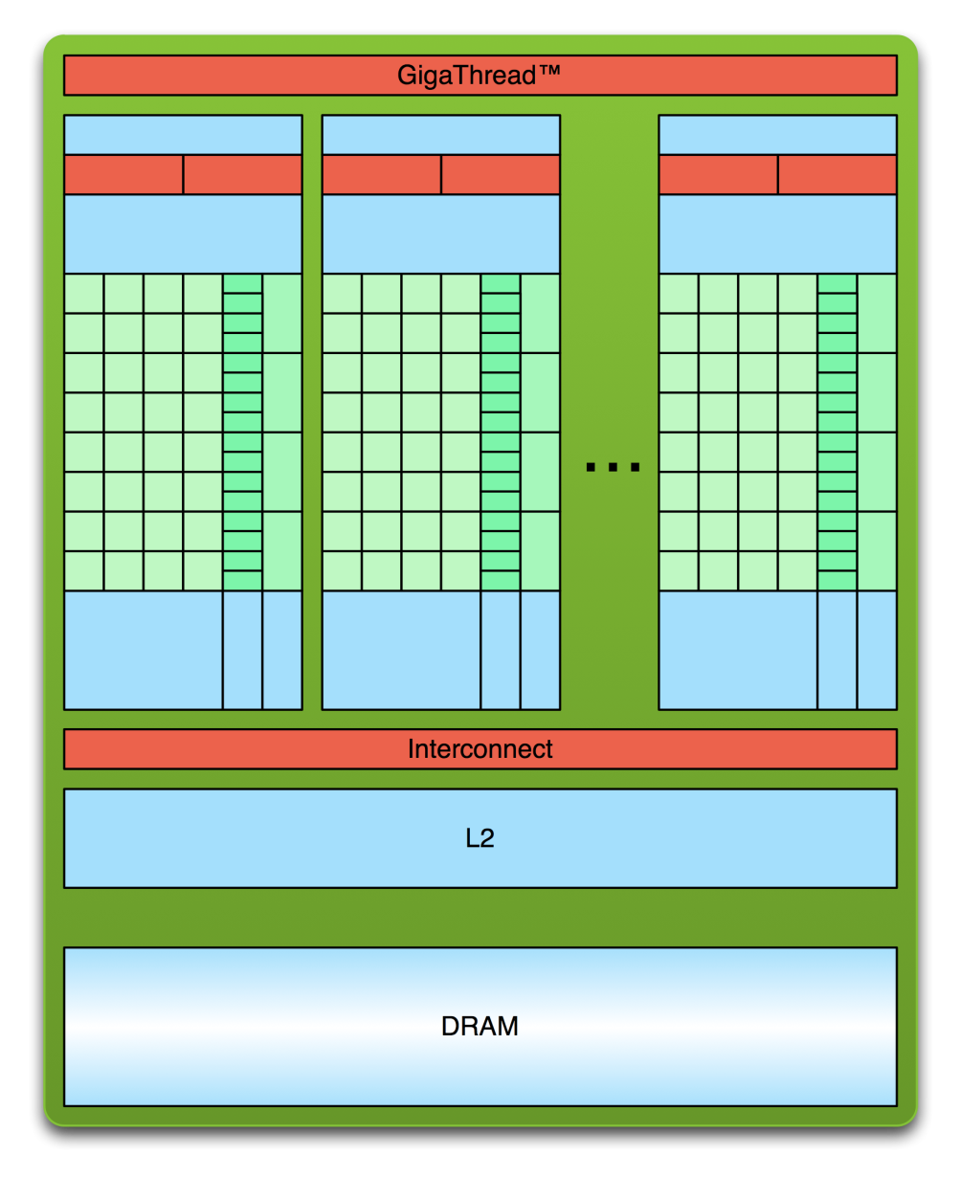
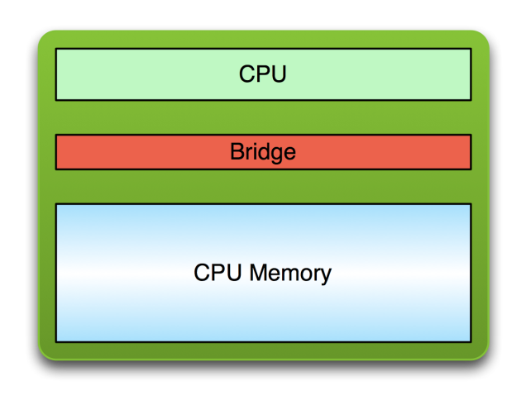
Simple Processing Flow
PCI Bus
Copy input data from CPU memory to GPU memory

Slide 41
Simple Processing Flow
PCI Bus
Copy input data from CPU memory to GPU memory
Load GPU program and execute, caching data on chip for performance

Slide 42
Simple Processing Flow
PCI Bus
Copy input data from CPU memory to GPU memory
Load GPU program and execute, caching data on chip for performance
Copy results from GPU memory to CPU memory

Slide 43

Hello World!
Output:
$ nvcc hello_world.cu
$ a.out
Hello World!
$
int main(void) {
printf("Hello World!\n");
return 0;
}
Standard C that runs on the host
NVIDIA compiler (nvcc) can be used to compile programs with no device code (we’re using Visual Studio though)

Slide 44
Hello World! with Device Code
__global__ void mykernel(void)
{
}
int main(void) {
mykernel<<<1,1>>>();
printf("Hello World!\n");
return 0;
}
Two new syntactic elements…

Slide 45
Hello World! with Device Code
__global__ void mykernel(void) {
}
CUDA C/C++ keyword __global__ indicates a function that:
Runs on the device
Is called from host code

Slide 46
Hello World! with Device Code
mykernel<<<1,1>>>();
Triple angle brackets mark a call from host code to device code
Also called a “kernel launch”
All that’s required to execute a function on the GPU!
Our kernel doesn’t do anything yet…

Slide 47
Next week’s Workshop
Creating and running your first CUDA program.
Doing something (slightly) more interesting: vector addition.
Benchmarking the performance.
Don’t forget to choose a session on the DLE.
See you next week!

